Slide 1
Reserve Land and Environment Management Program (RLEMP) 101
January 2025

Slide 2
What is RLEMP?
The Reserve Land and Environment Management Program (RLEMP) is an ISC land management capacity building program created in 2005. It provides funding to First Nations to build capacity and to offset the costs of managing land, natural resources and the environment on reserve lands under the Indian Act.
Through RLEMP, a First Nation trains a land manager through the Professional Lands Management Certification Program (PLMCP). This supports First Nation land managers in developing the skills and knowledge required to perform highly technical land management functions.
RLEMP First Nations take on land management responsibilities, with support from ISC, and can prepare for further steps towards service transfer as they choose, such as through the Framework Agreement on First Nation Land Management (FAFNLM).

Slide 3
Levels of Responsibility in RLEMP
The program is structured into three progressive levels of responsibility that build capacity as communities assume greater responsibility in managing land activities:
Training and Development Level (80% of funding)
First Nations develop their land management capacity by attending RLEMP Training while ISC Regions continue to provide land management services to the First Nation.
Operational Level (100% of funding)
Once the land manager is certified, First Nations progress to the operational level and now assume primary responsibility for land management on reserve. The role of ISC Regions now shifts to one of support, as well as audit and approval of land management activities.
Delegated Authority Level (100% +15% of funding)
This level is currently closed to new First Nations but was established to provide a mechanism to obtain delegated authority under Sections 53 and 60 of the Indian Act.
First Nations with Delegated Authority perform all the operational level activities of RLEMP in addition to approving land transactions on behalf of the Minister of ISC.
First Nations at the Operational Level perform all the responsibilities for managing land transactions up to ministerial approval, which remains a responsibility of ISC.

Slide 4
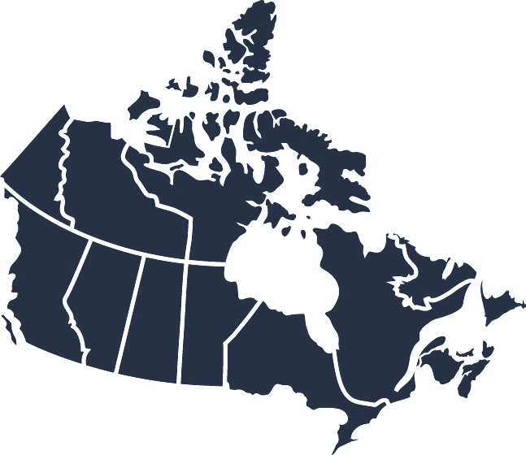
Current State of the Program
Distribution of the
148 RLEMP First Nations*
Training & Development First Nations (35 in total)
Operational First Nations (105 in total)
Delegated Authority First Nations (8 in total)
1/0/0
7/32/3
8/25/1
NWT
4/20/2
2/8/1
4/9/1
2/7/0
7/4/0
BC
AB
SK
MB
ON
QC
ATL
*Updated as of January 2025

Slide 5
RLEMP Entry Process
First Nation expresses interest in joining RLEMP to Indigenous Services Canada (ISC)
ISC reviews First Nation application against program guidelines and available funding
Once approved, the First Nation submits a Band Council Resolution to enter the Program
Training & Development: Training a land manager through the Professional Lands Management Certification Program (PLCMP)
First Nation is fully Operational once a land manager has been certified by the National Aboriginal Lands Managers Association (NALMA)
1
2
3
4
5

Slide 6
RLEMP – Training and capacity support
First Nations in RLEMP are funded to train a land manager for their community through the Professional Lands Management Certification Program (PLMCP) and provided further funding to offset costs to operate a lands office.
PLMCP delivery has been transferred to the National Aboriginal Land Managers Association (NALMA), which provides professional development and technical expertise support in relation to land management for First Nations. Students complete the PLMCP in two levels to receive certification:
For land managers with significant experience, NALMA offers a Prior Learning Assessment to recognize existing knowledge and expertise.
Level One | Level Two
Post-secondary training on the broad fundamentals of land management and related concepts delivered through partner universities. | Technical training on land management activities delivered by NALMA in various locations.
Available through Algoma University in Ontario, University of Saskatchewan, Vancouver Island University, and the Université du Québec en Abitibi-Témiscamingue. | Focuses on the specific roles and responsibilities of a First Nation land manager operating under the Indian Act.
A land manager may select the university of his/her choice

Slide 7
Training supports RLEMP’s Key Functions
Once a land manager has become certified through the PLMCP they will then lead activities in a First Nation’s land office to support and build capacity in areas such as:
Community land-use planning
Management of reserve land and natural resources
Completion of leases, permitting allotments, and other land instruments
Environmental Management
Compliance with policy and legislative frameworks

Slide 8
Budget 2023
Budget 2023 invested $30 million over five years, beginning in 2023-2024, to expand and enhance RLEMP. This will support First Nations in developing capacity to exercise increased responsibility over their lands, resources, and environment.
First Nations land management capacity-building through RLEMP supports the prerequisite land management activities (i.e., surveys, land assessments) needed to advance subsequent economic opportunities.
The announced funds are supporting critical program improvement efforts that were identified in a 2017 First Nations national engagement session and a 2023 internal evaluation of land management sub-programs.
Budget 2023 investments are enabling:
The introduction of a base-level of funding for RLEMP participants ($70,000 at the Operational Level); and
25 to 44 new First Nations to join RLEMP.

Slide 9
Questions?
Additional information on RLEMP can be found on ISC’s website:
Reserve Lands and Environment Management Program (sac-isc.gc.ca)
Questions can be directed to:
rlemp@sac-isc.gc.ca

